Slide 1
Safe Asynchronous Programming: Methodology, Language, and Tools
Introduction
PLDI 2019 Tutorials

Slide 2
Presenters
Pantazis Deligiannis, Microsoft Research, Redmond.
Ankush Desai, University of California, Berkeley.
Akash Lal, Microsoft Research, Bangalore
Shaz Qadeer, Facebook, Menlo Park.

Slide 3
Tutorial Outline
Part 1 (09:00 - 10:00) : Introduction to the P language.
Introduction, evolution of P, and an overview of the P language
Part 2 (10:00 – 11:00): P# Runtime.
Introduction and a tutorial on the P# programming framework, a C# runtime for P.
Part 3 (11:20 – 12:30): Building Distributed Services using P#
Building reliable distributed services using P# and the Reliable State Machines (RSM) framework (at Microsoft Azure) .
Part 4 (14:00 – 15: 30): Safety Testing of Async. Systems.
From scalable monolithic to compositional testing of asynchronous systems.
Part 5 (16:00 – 17:00): Liveness Testing of Async. Systems.
Specifying and Finding liveness violations in real-world distributed systems.

Slide 4

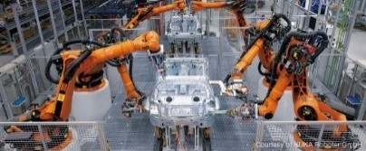


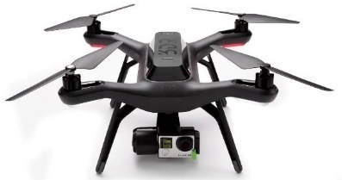

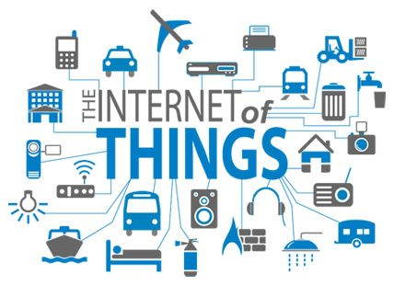
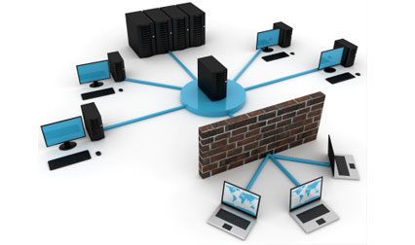
Event Driven Asynchronous Systems
Operating System, Device-Drivers, Web-Applications.
Industrial Automation, Robotic System, Cyber Physical Systems.
Distributed Systems, Distributed Storage.
Internet of Things.
Notes:
Most of the applications across domains are event-driven in nature consisting of processing communicating with each other by sending messages.
Device drivers in OS, web-app are event-driven.
Distributed systems by contruction are event-driven in nature as nodes communicate by sending messaging.
More recently, robotic applications are becoming more and more complex and are implemented as concurren event-driven systems.
To summarize, the paradigm of event-driven programming is becoming popular across domains as the applications are becoming more and more parallel and distributed in nature.

Slide 5
Characteristics of Event Driven Systems
Event-Driven Asynchronous System (actor model):
Collection of concurrently executing processes.
Processes can be created dynamically.
Processes communicate by asynchronously sending messages or events to each other (no shared memory).
Reactive Systems:
Processes in the system interact continuously with the environment.

Slide 6

Programming Event Driven Systems is Challenging
Non-determinism
Non-determinism
Sensor Failure
Node Failure
Uncertainties
Uncertainties
Fault Tolerance
Environment
Modeling
Fault Tolerance
Environment
Modeling
Message Loss
Message Loss
Reactivity
Reactivity
Safety
Specifications
Synchrony
Liveness!
Partial-Synchrony
Partial-Synchrony
Concurrency
Concurrency
Complex Interaction
Aynschrony
Composition
Multiple Components

Slide 7
Overview: P Framework
P Program
Implementation
Specification
Abstractions
Test
P Framework
P: State machine based language for safe event-driven programming [PLDI 2013].
P#: Asynchronous programming, analysis and testing with State machines in C# [PLDI 2015].
Modular P: Implements a module system for hierarchical and compositional reasoning [OOPSLA 2018].

Slide 8
Overview: P Framework
P Program
Implementation
Specification
Compiler
Toolchain
Abstractions
Test
Intermediate Code
Systematic
Testing
Tool
(Reproducible) Error Trace
P Framework
Scalable Analysis of Event-Driven Programs:
Search Prioritization and Random Testing [FSE 2015], [PLDI 2015].
Lasso Detection for Liveness Testing [FMCAD 2017]

Slide 9
Overview: P Framework
P Program
Autogen C Impl.
Deployment
tool
Autogen Impl.
P
Runtime
Wrappers
Implementation
Wrappers
Specification
OS, Libs
Compiler
Toolchain
Abstractions
Target Platform
Test
Intermediate Code
Systematic
Testing
Tool
(Reproducible) Error Trace
P Framework
Build Safe Real-World Systems:
Windows Device Drivers (USB 3.0) [PLDI 2013, OOPSLA 2014]
Fault Tolerant Distributed Systems [FAST 2016, OOPSLA 2018, ECOOP2019].
Safe Robotic Systems [ICCPS 2017, DSN 2019]

Slide 10
Origin P (USB 3.0)

Slide 11
Teams that Used/Adapted P

Slide 12
Impact of P#

Slide 13
Journey and Learnings from P to P#

Slide 14
Positioning P and P#
Where does P position with respect to TLA and Mace.

